Slide 1

HOUSE PRICE PREDICTION
A Report
Submitted in partial fulfillment of the requirements for the Final Year Project of HOUSE PRICE PRIDICTION USING MACHINE LEARNING
By
Gaurav Soni (Roll no.: 0204696 Sec: B)
Gyanendra Kumar (Roll no.: 0204698 Sec: B)
Harshit Shukla (Roll no.: 0204708 Sec: B)
Under Guidance Of
Dr. Mayur Rahul Sir
Department Of Computer Application
UIET
CSJM UNIVERSITY Kanpur
2019-2022
Bachelor of Computer Application

Slide 2
UIET CSJM university Kanpur Department of Computer Applications CERTIFICATE
Date:__/__/ 2022
This is to certify that the report of project work entitled HOUSE PRICE PRIDICTION USING MACHINE LEARNING is being submitted by Gaurav Soni (Roll no.: 0204696 Sec: B), Gyanendra Kumar (Roll no.: 0204698 Sec: B) and Harshit Shukla (Roll no.: 0204708 Sec: B)in partial fulfillment of the requirements for the Final Year Project of (department name) to the University Institute of Engineering & Technology, CSJM University, Kanpur during the academic year 2019-22 is a record of bona fide work carried out by him under our guidance and supervision .
The results embodied in this report have not been submitted by the student(s) to any other University or Institution for the award of any degree or diploma.
Internal Guide Head of Department
DR. MAYUR RAHUL SIR AMIT VIRMANI SIR

Slide 3
ACKNOWLEDGEMENT
I express my deep sense of gratitude to my Director (UIET IV) for the valuable guidance and for permitting us to carry out this project.
With gratitude,
Name : GAURAV SONI(Roll no.: 0204696 Sec: B)
Name : GYANENDRA KUMAR(Roll no.: 0204698 Sec: B)
Name : HARSHIT SHUKLA(Roll no.: 0204708 Sec: B)

Slide 4
CONTENTS
ABSTRACT
LIST OF FIGURES
LIST OF TABLES
1. Introduction Of Project
2. Objective Of The Project
3. Scope Of The Project
4. Project Plan
5. The Existing System
6. Current Problems
7. Areas For Improvement
8. Proposed System
9. Input/Output Requirement
10. Hardware And Software Requirement

Slide 5
11. Database Requirement
12. Software Requirment Specification
13. Tables And Fields For Database
14. Database Dictionary
15. E-R Diagram
16. Screen Shots
17. Validation Checks
18. Testing
19. Implementation and Maintenance
20.Future Scope Of The Project
21.Conclusion
22. Bibliography

Slide 6
ABSTRACT
House prices increase every year, so there is a need for a system to predict house prices in the future.
Predicting House Prices with real factors.
We aim to make evaluations based on every basic parameter that is considered while determining the price.
It Is a Machine Learning model which integrates Data Science and Web Development.
The goal of this project is to learn Python and get experience in Data Analytics, Machine Learning, and AI.

Slide 7
INTRODUCTION
Machine learning is a subfield of Artificial Intelligence (AI) that works with algorithms and technologies to extract useful information from big data.
There are two types of machine learning. These are following.
Supervised learning
Unsupervised learning
Supervised learning: Supervised learning is a type of machine learning method in which we provide sample labeled data to the machine learning system in order to train it, and on that basis, it predicts the output.
Supervised learning can be grouped further in two categories of algorithms:
Classification
Regression

Slide 8
Unsupervised learning: In Unsupervised Learning, the machine uses unlabeled data and learns on itself without any supervision. The machine tries to find a pattern in the unlabeled data and gives a response.
Unsupervised learning can be further grouped into types:
Clustering
Association
We use supervised learning to predict our house price.

Slide 9
OBJECTIVE
There are following objective of House PricePrediction Machine Learning. These are
Predict the sale price for each house.
Minimize the difference between predicted and actual rating.

Slide 10
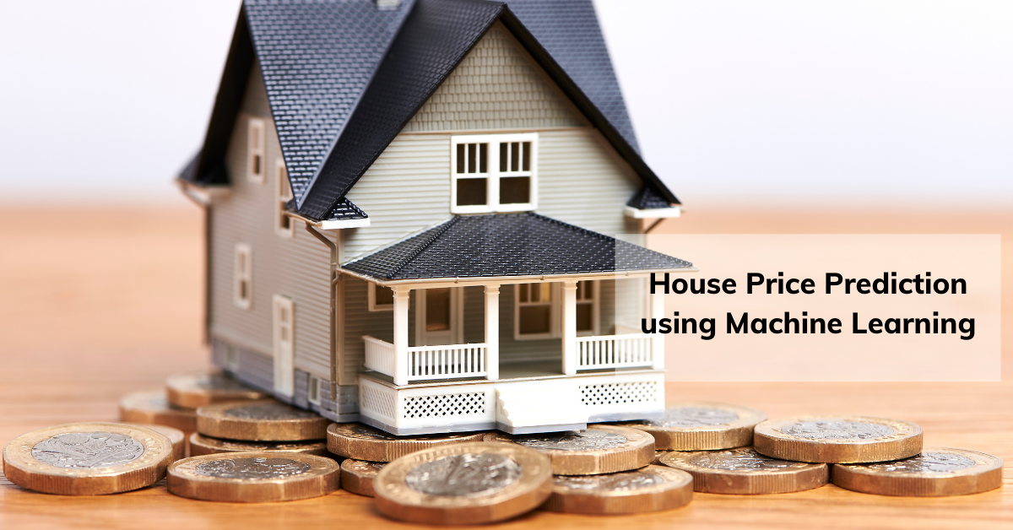
SCOPE
It is a website at which you have to enter required input to get price.

Slide 11
PROJECT PLAN
Data Collection: We take appropriate database from online data repository site for our House Prediction project process.
Data Analysis: We analyze the data by making graphs, checking missing data points and removing outliers. Following are step to analyze data.
We use different regression model to know which model predict best price.
Linear Regression: Linear regression is a supervised learning technique. It is responsible for predicting the value of a dependent variable (Y) based on a given independent variable (X). It is the connection between the input (X) and the output (Y). It is one of the most well-known and well-understood machine learning algorithms. Simple linear regression, ordinary least squares, Gradient Descent, and Regularization are the linear regression models.

Slide 12
Decision Tree Regression: It is an object that trains a tree-structured model to predict data in the future in order to provide meaning ful continuous output. The core principles of decision trees, Maximizing Information Gain, Classification trees, and Regression trees are the processes involved in decision tree regression. The essential notion of decision trees is that they are built via recursive partitioning. Each node can be divided into child nodes, beginning with the root node, which is known as the parent node. These nodes have the potential to become the parent nodes of their resulting offspring nodes. The nodes at the informative features are specified as the maximizing information gain, to establish an objective function that is to optimize the tree learning method.
Random Forest Regression It is an essential learning approach for classification and regression to create a large number of decision trees. Preliminaries of decision trees are common approaches for a variety of machine learning problems. Tree learning is required for serving n off the self-produce for data mining since it is invariant despite scaling and several other changes. The trees are grown very deep in order to learn a high regular pattern. Random forest is a method of averaging several deep decision trees trained on various portions of the same training set. This comes at the price of a slight increase in bias and some interoperability

Slide 13
3. Performance evaluation : We evaluate performance using following method.
Mean Square Error : Mean Square Error is a measure for how close the estimation is relative to the actual data. It measures the average of the square of the errors deviation of the estimated values with respect to the actual values. It is measured by:
MSE = (1 /n) ∑^{n}_{i=1} (y1−y) ²
Where y1 is the estimated value from the regression and y is the actual value. The lower the MSE, the better the estimation model.
Root Mean Squared Error
Root mean squared error (RMSE) is the square root of the mean of the square of all of the error. The use of RMSE is very common, and it is considered an excellent general-purpose error metric for numerical predictions.
RMSE=(1/n(∑_{i=1}^{n}(S_{i}-O_{i})²))^{1/2}
where O_{i} are the observations, S_{i} predicted values of a variable, and n the number of observations available for analysis. RMSE is a good measure of accuracy, but only to compare prediction errors of different models or model configurations for a particular variable and not between variables, as it is scale-dependent.

Slide 14
The Existing System
The present system is not dunce proof and has certain drawbacks. Being a manual system the possible limitations and loopholes in the present system is large. Some of them are:-
HUMAN resource: - The current system has too much manual work from filling a form to filing a document, delivering manifesto. This increases burden on workers but does not yield the results it should.
THORNY Job: - In current system if any modification is to be made it increases manual work and is error prone.
ERROR: - As the system is managed and maintained by workers errors are some of the possibilities.

Slide 15
Current Problems
The Existing System cannot predict the exact price of house that is why sometime many company faces loss.

Slide 16
Areas For Improvement
There are following areas for improvement.
Minimize the difference between predicted and actual rating.
Design such model to predict best price of house .

Slide 17
Proposed System
Proposed system is an website.
Proposed system uses the parameters such as BHK_NO, size of the property, location and other parameters for house price prediction.
Proposed system is built using visual studio as front-end technology.

Slide 18
Input/Output Requirement
Input:
Rera(Real Estate Regulatory Authority) approved or Not
BHK _No
Total Square Feet - size of the property in square feet
Address of the property
Under Construction or Not
Output:
House price prediction using ML supervised learning technique.

Slide 19
Hardware And Software Requirement
Hardware Requirement:
A computer system or laptop with internet and wifi facilitiy
Operating system: Window 8 or greater
Software Requirement :
We use following software to develop our project
Python interpreter
Visual Studio/Jupyter Notebook
A web browser such as chrome

Slide 20
Database Requirement
Dataset should contain large number of entities so that it will increase the accuracy of the predicted price and suggest a better property.

Slide 21
Software Requirment Specification
Functional Requirements: A Functional Requirement is a description of the service that the software must offer. It describes a software system or its component. A function is nothing but inputs to the software system, its behavior, and outputs.
USER INTERFACE: The user interface will be a website. The user has to enter all the attributes correctly and in the required format.
PROPER FORECASTING: The system has to properly predict the price of the house according to the input given by the user.
RECOMMENDATION SYSTEM: According to the input given by the user, the recommendation system will recommend the best property.
DATABASE: Dataset should contain large number of entities so that it will increase the accuracy of the predicted price and suggest a better property.

Slide 22
2. Non-Functional Requirements: Non Functional Requirements are the constraints or the requirements imposed on the system. They specify the quality attribute of the software. Non-Functional Requirements deal with issues like scalability, maintainability, performance, portability, security, reliability, and many more
Platform Independent: The application would be platform independent if all the requirements are installed in the device.
Performance: The application should have better accuracy and should provide the information in less time.
Capacity: The capacity of the storage should be high so that large amount of data can be stored in order to train the model.

Slide 23
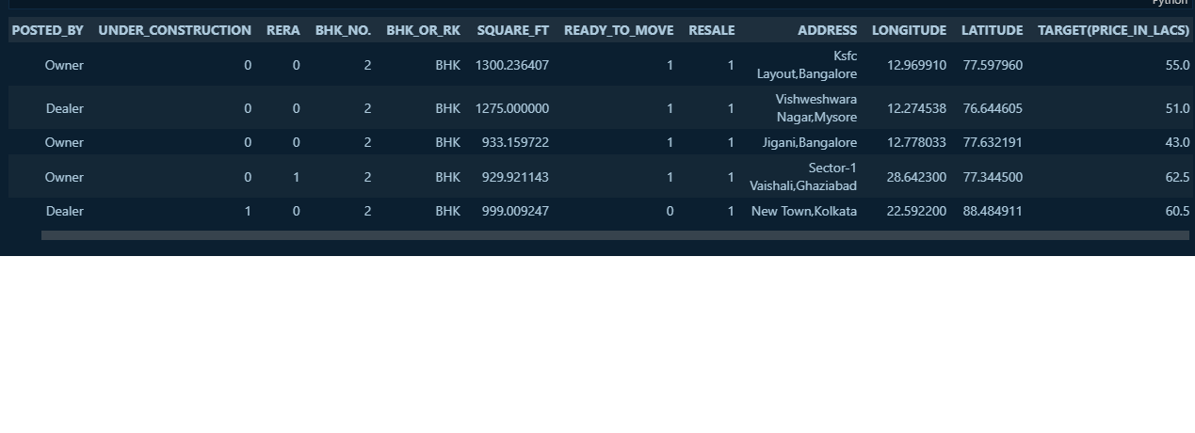
Tables And Fields For Database

Slide 24
Database Dictionary
COLUMN | DATA TYPE | SIZE OF DATA
POSTED_BY | Object(string) | 29460
UNDER_CONSTRUCTION | int | 29460
RERA | int | 29460
BHK_NO | int | 29460
SQUARE_FT | float | 29460
READY_TO_MOVE | int | 29460
RESALE | int | 29460
ADDRESS | Object(string) | 29460
LONGITUDE | float | 29460
LANGITUDE | float | 29460
TARGET(PRICE IN LACS) | float | 29460

Slide 25
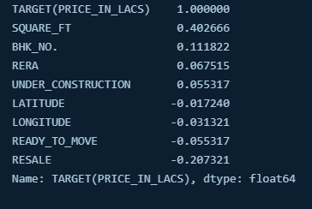

Slide 26
E-R Diagram
Process
The
data
output
input
BHK
Sqft
location
price

Slide 27
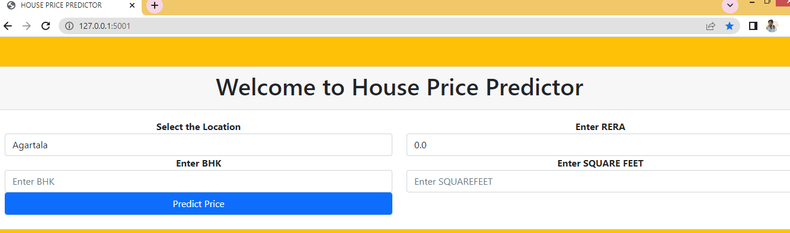
Screen Shots

Slide 28
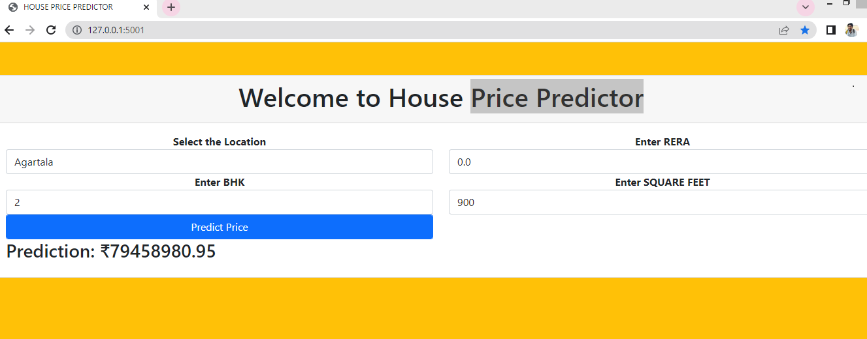

Slide 29
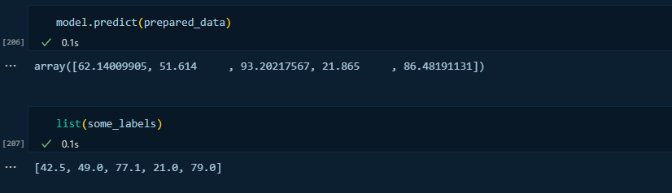
Validation Checks

Slide 30
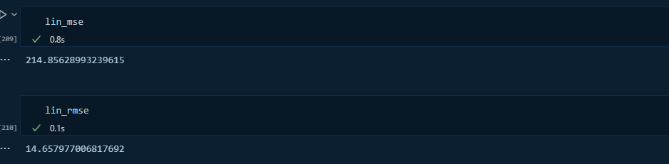
Testing

Slide 31
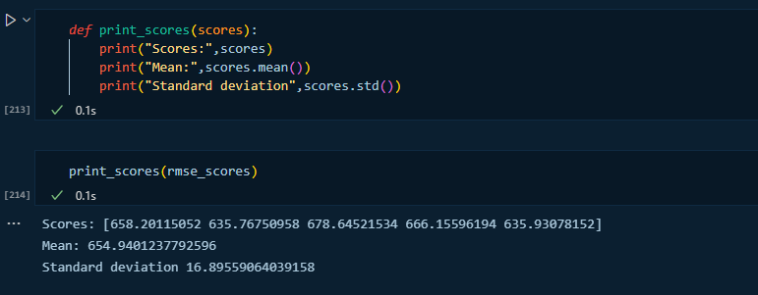

Slide 32
Implementation and Maintenance
Import Libraries: library is a collection of related modules. It contains bundles of code that can be used repeatedly in different programs.
We use following library in python
Pandas
Numpy
Sklearn
seaborn
Load Dataset: It is process of reading and loading of data from csv file.
Exploratory Data Analysis: EDA is a phenomenon under data analysis used for gaining a better understanding of data aspects like: – main features of data – variables and relationships that hold between them – identifying which variables are important for our problem

Slide 33
Data Cleaning: Data cleaning is the process of fixing or removing incorrect, corrupted, incorrectly formatted, duplicate, or incomplete data within a dataset. When combining multiple data sources, there are many opportunities for data to be duplicated or mislabeled.
Feature Engineering: Feature engineering (or feature extraction) is the process of using domain knowledge to extract features (characteristics, properties, attributes) from raw data. The motivation is to use these extra features to improve the quality of results from a machine learning process, compared with supplying only the raw data to the machine learning process.
Outlier Removal: An Outlier is a data-item/object that deviates significantly from the rest of the (so-called normal) objects. They can be caused by measurement or execution errors. The analysis for outlier detection is referred to as outlier mining.
Data Visualization: Data visualization is the graphical representation of information and data.
Building a Model: After passing through above steps, we create appropriate model.
Test the Model for few properties: After building model now we test model and check rmse.
Export the tested model to a joblib file:Now we save tested model using joblib library.

Slide 34
Future Scope Of The Project
Our model had a low rise score, but there is room for improvement. In a real world scenario, we can use such a mode to predict house prices. This model should check for new data, once in a month, and incorporate them to expand the dataset and produce better results.
We can try out other advanced regression techniques, Random Forest and Bayesian Ridge Algorithm, for prediction. Since the data highly correlated and improve our proje.ct

Slide 35
Conclusion
As we discussed about machine learning and its type briefly and collect information from various online sources. We conclude that Supervised learning is used to design House Price Prediction. Here we have to know real entity i.e. price so use regression to solve this. After a analysis now we start implementation of this project.

Slide 36
Biblography
https://datasetsearch.research.google.com/search?query=house%20price%20%20pridiction&docid=L2cvMTFxbDFxMjVxaw%3D%3D
https://www.kaggle.com/anmolkumar/house-price-prediction-challenge
https://towardsdatascience.com/tagged/house-price-prediction?p=dea265cc3154
https://www.geeksforgeeks.org/regression-classification-supervised-machine-learning/
https://www.geeksforgeeks.org/machine-learning/

